Slide 1
First Generation Refugee Families in United States
Abdullah Hassan

Slide 2
Context, Motivation, Method/Sources
As per the United Nations, 80+ million people displaced by the end of 2020.
Due to increase in Conflict, violence, persecution and human rights violations.
We’ll be looking at trends of Refugee families that resettled in the U.S overtime.
This is my passionate story since I came to U.S as a Somali Refugee in 2004.
Data Analysis Method-Find Data-Cleaning and visuals in Excel & Power Bi.
Data Sources include Department of State, UNHCR, Migration Policy Institute.

Slide 3
Terminology
A refugee is a person who has fled their own country for safety and security due to being at risk of serious human rights violations and persecution if they stay.
Asylum-seeker is a one who has left their country to seek protection from serious human rights violations in another country, but not legally recognized a refugee.
Affirmative asylum processing involves your physical presence in the United States while defensive asylum is when requesting asylum to prevent removal
Internally displaced persons(IDPs) due to conflict and violence in a country.
The United Nations High Commissioner for Refugees(UNHCR) is a UN agency mandated to aid and protect refugees, forcibly displaced communities, to assist in their voluntary repatriation, local integration or resettlement to third country.

Slide 4
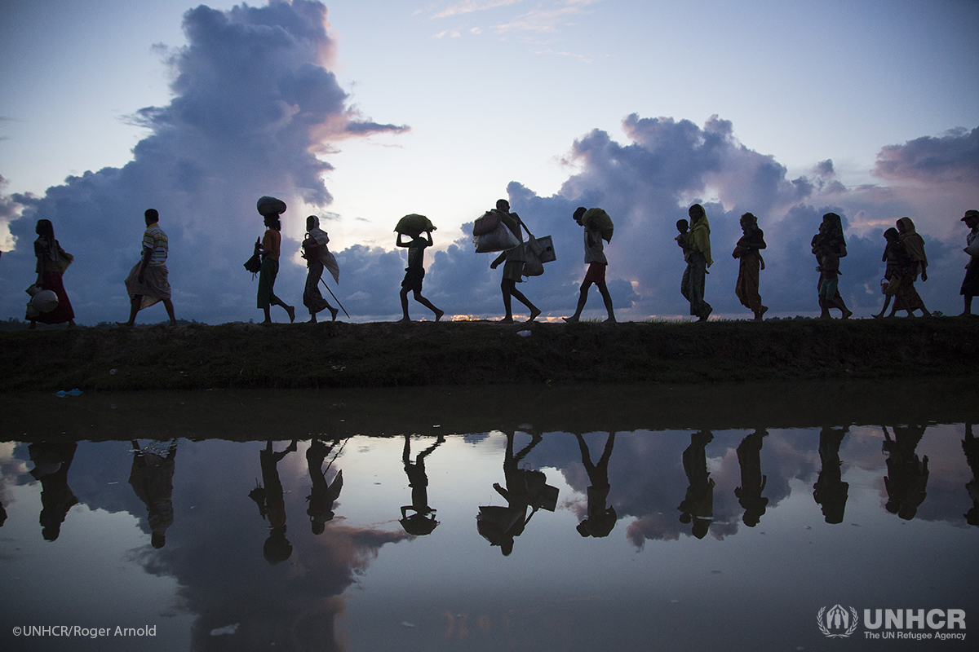
Journey Of A Refugee
Refugee will first likely Flee to neighboring host Countries.
Most end up in a refugee Camp.
Some are sent back to his/her home country as Voluntary Repatriation.
One 1% get to resettle in third country like U.S for Opportunities.
Since 1980, the U.S. has resettled more refugees than other country.

Slide 7
U.S. Refugee Ceiling & Resettlement

Slide 8
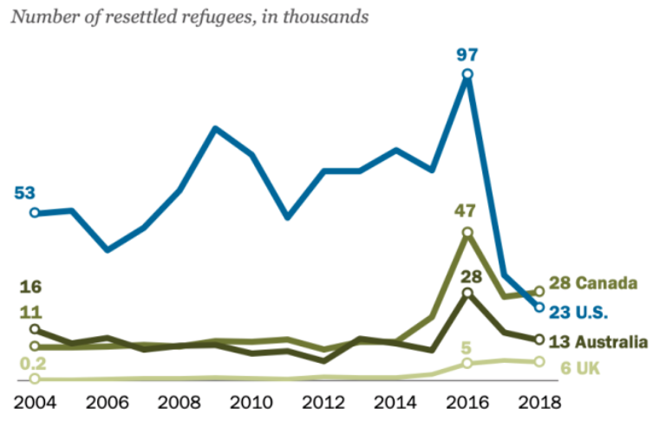
U.S. refugee resettlement drop
https://www.weforum.org/agenda/2019/06/canada-now-leads-the-world-in-refugee-resettlement-surpassing-the-u-s/

Slide 9
Top 10 Countries

Slide 10
Asylum Seekers

Slide 11
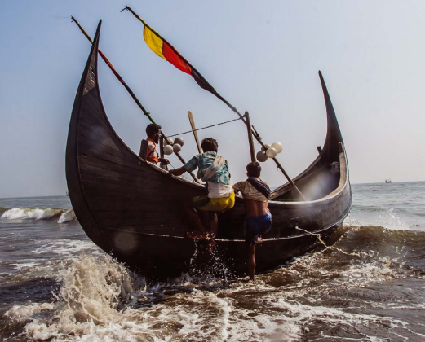
Refugees Resilience and Struggles
Refugees face challenges fleeing their home.
By land, sea, or air with only their lives.
In search for a place that offer safety etc.
Refugees suffer from (PTSD) especially kids.
Some have horror stories we can’t imagine.
They still strive to carry on with their lives.
These that get opportunity to resettle in U.S strive to integrate and give back in many ways.

Slide 12

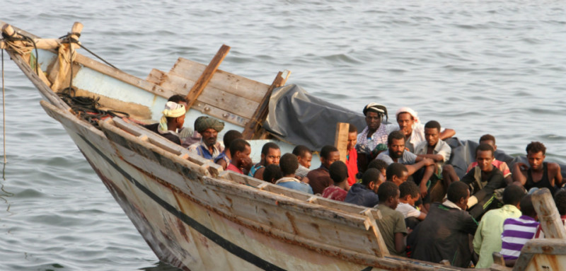
Finding and Recommendations
U.S is known to be top of Countries with the funding to Resettle more Refugees.
Canada resettled more refugees(28,100) in 2018, since the U.S 1980 Refugee Act.
Its time to get back the lead for U.S.
Improve Health Care and Education programs that’s more geared towards immigrant families, especially refugees.
More options for Voluntary Return for refugees that can rebuild their countries.

Slide 13




Local and International Refugee Agencies
Local
International

Slide 14
Reference & Articles
https://www.wrapsnet.org/admissions-and-arrivals/
https://www.migrationpolicy.org/proghttps://immigrationforum.org/article/fact-sheet-u-s-refugee-resettlement/rams/data-hub/charts/immigrant-population-over-time
https://www.dhs.gov/immigration-statistics/refugees-asylees
https://www.weforum.org/agenda/2019/06/canada-now-leads-the-world-in-refugee-resettlement-surpassing-the-u-s/
https://refugees.org/as-a-former-refugee-i-am-part-of-americas-story/
https://www.weforum.org/agenda/2019/01/from-a-refugee-camp-to-davos-one-co-chair-s-story
Thank you!

